Slide 1
Introducing yourself
Do you remember how to introduce yourself in Welsh?
Slide 2:Marcus Rashford has written a description of himself in Welsh.
Slide 3:Use the description on slide 2 as a model to write about
yourself in Welsh.
Remember you can use the Mat Iaith and the Mat Geirfa (Vocabulary Mat)
to help you.

Slide 2
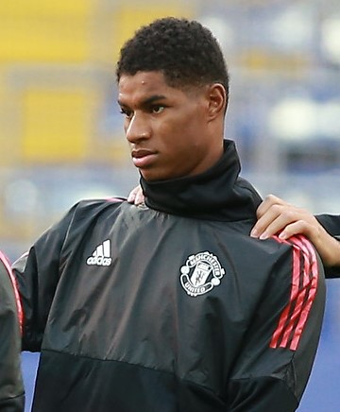
Marcus Rachford
Listen and read the description of Marcus Rashford
Marcus Rashford ydw i, dw i’n 23 oed a dw i’n byw yn Hale, Cheshire. Mae gen i ddau frawd o’r enw Dwaine a Dane a hanner chwaer o’r enw Tamara.
Dw i’n hoffi bwyta salad cyw iâr ond dw i ddim yn hoffi cacen siocled.
Dw i’n mwynhau chwarae pêl-droed i Manchester United ond dw i ddim yn mwynhau chwarae rygbi o gwbl. Mae rygbi yn ddiflas iawn.
hanner chwaer – half sister
cyw iâr – chicken
cacen siocled – chocolate cake
mwynhau - enjoy
o gwbl – at all
ddiflas iawn – very boring
Notes:
Use the Mat Disgrifio to practice dw I’n / dw I ddim yn …….etc
You can also use the Mat Disgrifo to extend your character descriptions to include parts of the body e.g trwyn/gwallt/llygaid and colours
Personal Profile
Teacher/pupils to read Ant's Personal profile. Teacher to assess pupils’ understanding by asking questions about the text e.g
• Beth ydy enw Ant? – What is Ant’s (full) name?
• Ble mae Ant yn byw?- Where does Ant live?
• Faint ydy oed Ant? – How old is Ant?
• Oes ganddo fo frawd/chwaer ? - Does he have a brother/sister?
• Beth ydy hobi Ant?What’ is Ant’s hobby?
• Which sentence tell me that……….? etc
Pupils to discuss which elements of the paragraph could be changed ( written in red)
Pupils to write their own personal profile using the model above ( substituting specific information)
Pupils to read aloud /record their personal presentation. .
EXTENSION:
Pupils to offer ideas on how to improve their Personal Presentation.

Slide 3
Write your own personal description
TASK:
Use the description of Marcus Rashford as a model to write a description of yourself.
Draw/take a picture of yourself to go with your description.
Record yourself reading your work.
… ydw i, dw i’n … oed a dw i’n byw yn … . Mae gen i …. Dw i’n hoffi bwyta … ond dw i ddim yn hoffi … .
Dw i’n mwynhau …ond dw i ddim yn mwynhau…. Mae … yn ….

