Slide 1
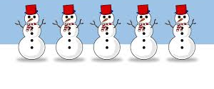
Maths/Music
To the tune of ‘I’m a little teapot’.
I'm a little snowman short and fat,
Here's my scarf and here's my hat.
When I see the snowfall,
Hear me shout
- All you children please come out!
Five Little Snowmen
Five little snowmen standing in a line
One, Two, Three, Four, Five
So fine
Melt in the sunshine with a sigh
We'll see you next year
Bye Bye!
Four little snowmen standing in a line
One, Two, Three, Four
So fine
Melt in the sunshine with a sigh
We'll see you next year
Bye Bye!
Three little snowmen standing in a line
One, Two, Three
So fine
Melt in the sunshine with a sigh
We'll see you next year
Bye Bye!
Two little snowmen standing in a line
One, Two
So fine
Melt in the sunshine with a sigh.
We'll see you next year
Bye Bye!
One little snowmen standing in a line
One
So fine
Melt in the sunshine with a sigh
We'll see you next year
Bye Bye!
https://www.youtube.com/watch?v=1j0EwZ6Ov08 To listen to the tune

