Slide 1
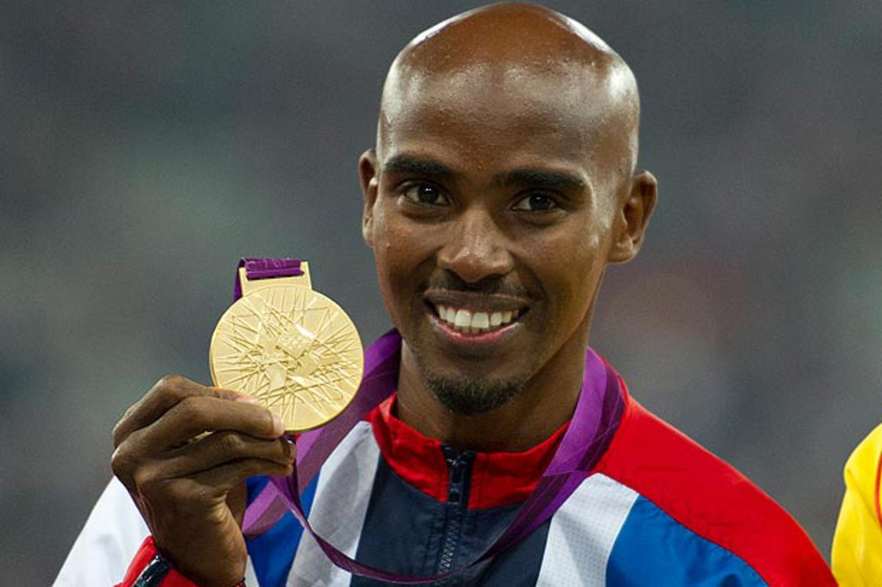
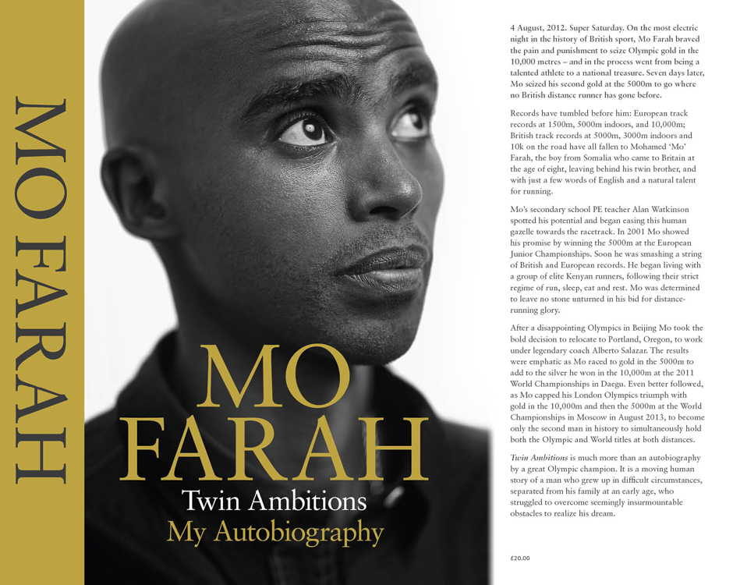
Looking at an autobiography We are going to look at part of the autobiography of Mo Farah. He is a British athlete who has won a lot of gold medals at the Olympics.
https://www.youtube.com/watch?v=C93qwVmBseE

Slide 2
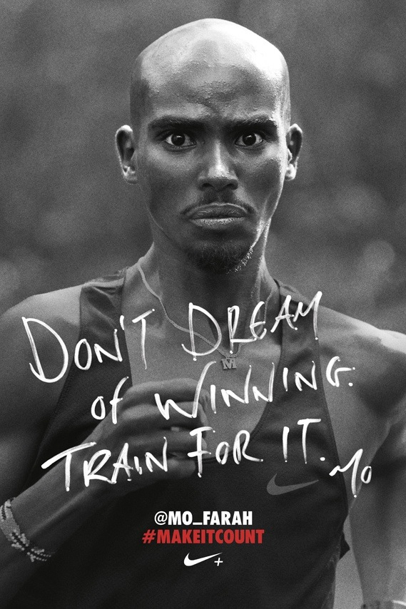
Race Day “My hands are trembling. My eyes feel as though they’re about to burst out of their sockets”. “It’s the biggest day, the biggest moment of my life. Everything has been leading to this. I’m looking around and telling myself, “This is my moment. This is it”. I am ready to race”. How is Mo Farah feeling before his race? How do you know?

Slide 3
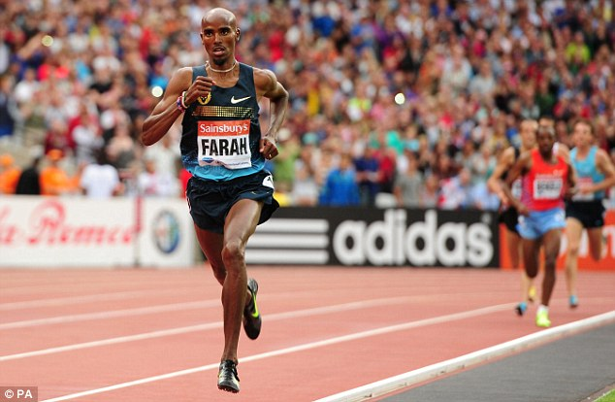
In the Race “The race gets faster. But I’m calm. I know I’ve got my sprint finish. As long as I’m near the front with two laps to go, I’m good”. “This is my race. My time. I’m not going to lose to anyone. Not here. Not in front of my home crowd, with everyone in the country cheering me”. Write at least 3 words to describe how you think Mo is feeling during the race.

Slide 4
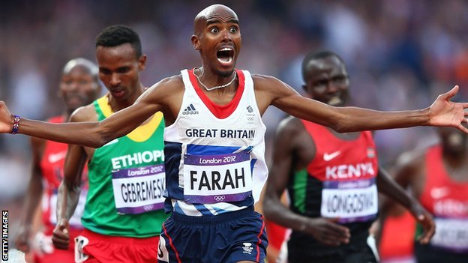
Winning the Race “It’s only once I cross the line that it hits me. I’ve won”. “The whole stadium just erupts. The crowd is unbelievable. The noise is deafening – like nothing I’ve ever heard before. Everywhere I look is this mass of noise and colour”. How do you think Mo feels now he has won the race? How do you think the people watching are feeling?

Slide 5
Your Task: Write about a time in your life you have felt nervous or excited. Was it your first day in School? Was it going on stage to sing, dance or perform? Was it going to the dentist? Was it at Christmas or your birthday party? Was it playing in a match or running a race? Was it going to a concert or to see your favourite team play? Was it going somewhere new for the first time? How did you feel before? How did you feel during? How did you feel after? Try to tell the story using as much detail as you can.

